Slide 1
Creating a series of build for related jobs

Slide 2
Job Chaining
Create three jobs (Java Hello Program – 1)
Java Msg (“ Full Stack Section”) - 2
Java Msg (“Student Name”)-3
Create sequence among them
They will be executed one by one
Show build and post build actions.

Slide 3

Job chaining in Jenkins is the process of automatically starting other job(s) after the execution of a job.
This approach lets you build multi-step Jenkins build pipelines or trigger the rebuild of a project if one of its dependencies is updated
Jenkins is a popular server-based automation tool that is used to implement continuous integration pipelines.
Jenkins Build Pipelines can be further configured for continuous delivery by using Pipeline plugins in both declarative and scripted DSLs.

Slide 4

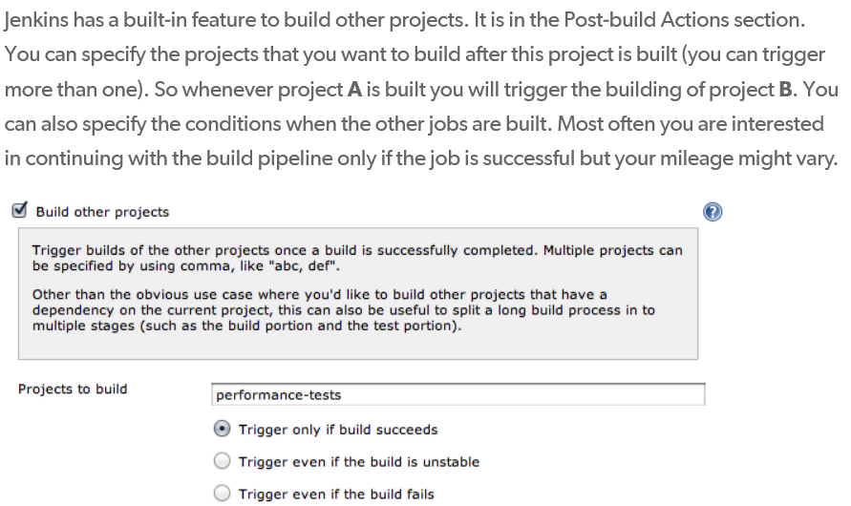

Slide 5
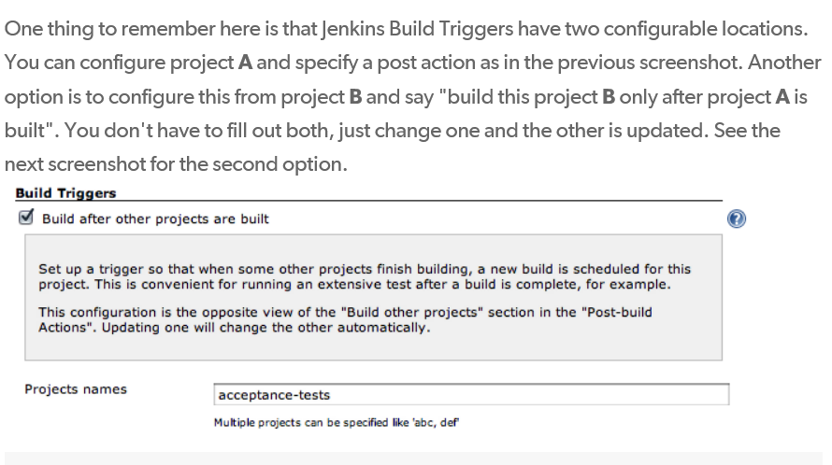

Slide 6

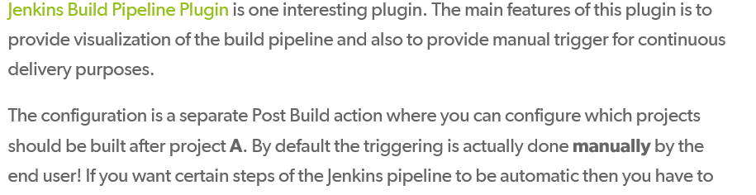

Slide 7
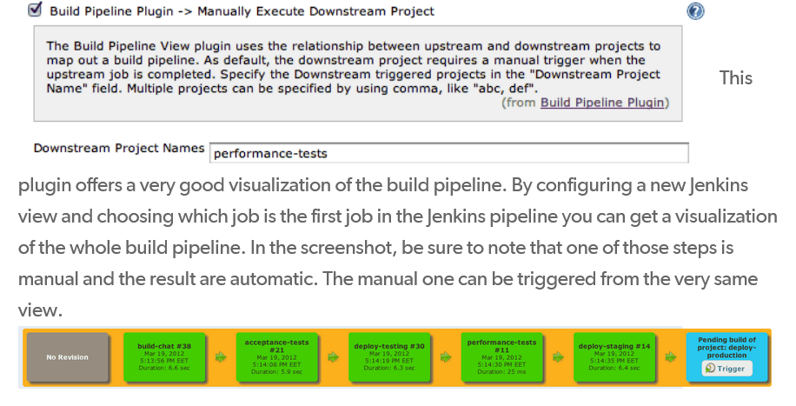

Slide 8
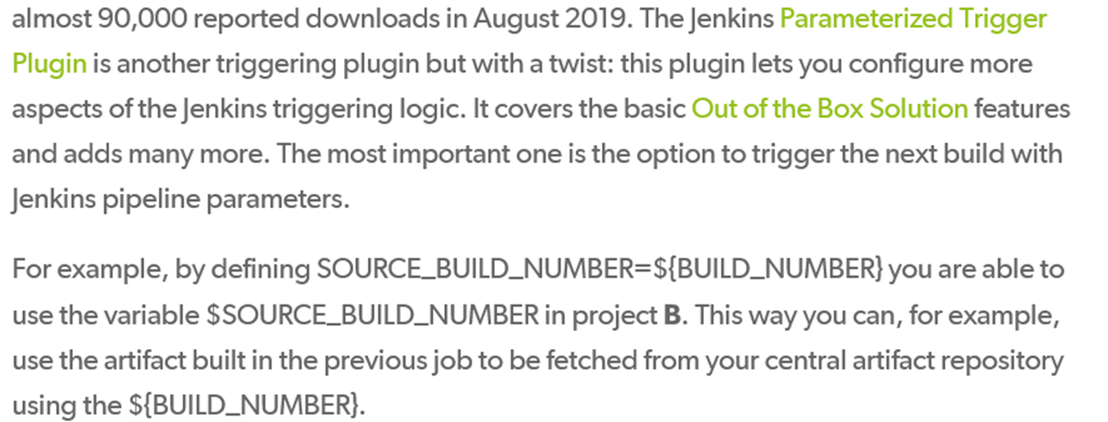
Jenkins Parameterized Trigger

Slide 9

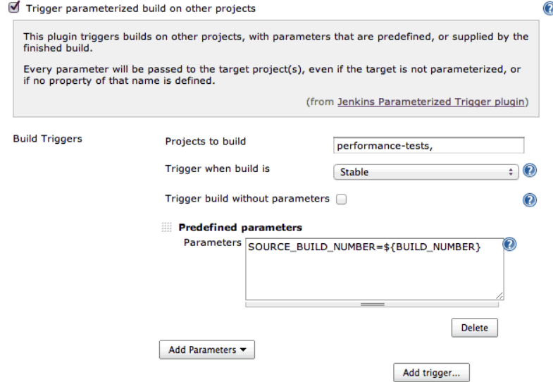

Slide 10
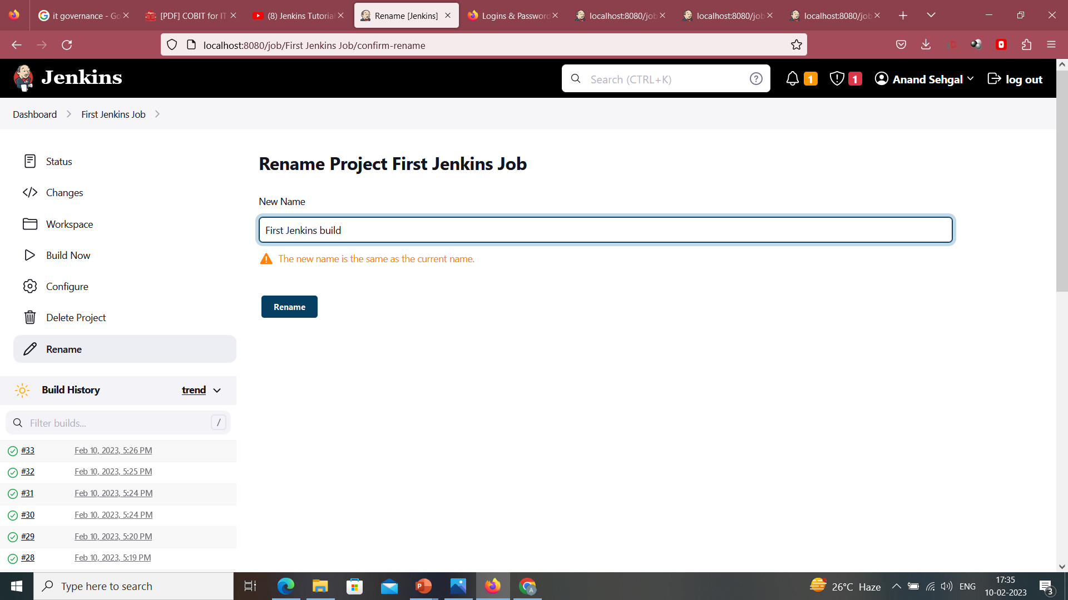

Slide 11
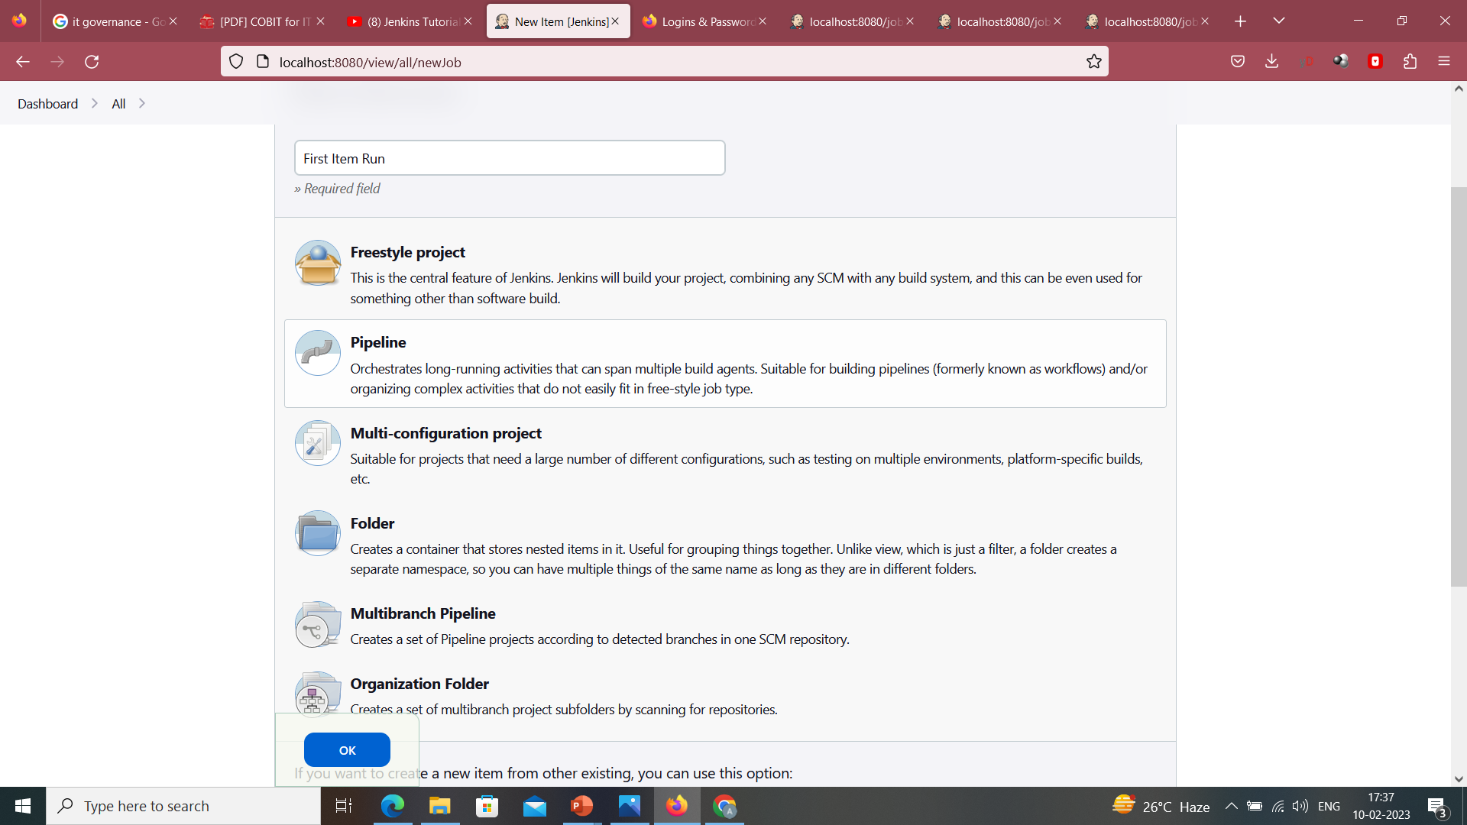

Slide 12
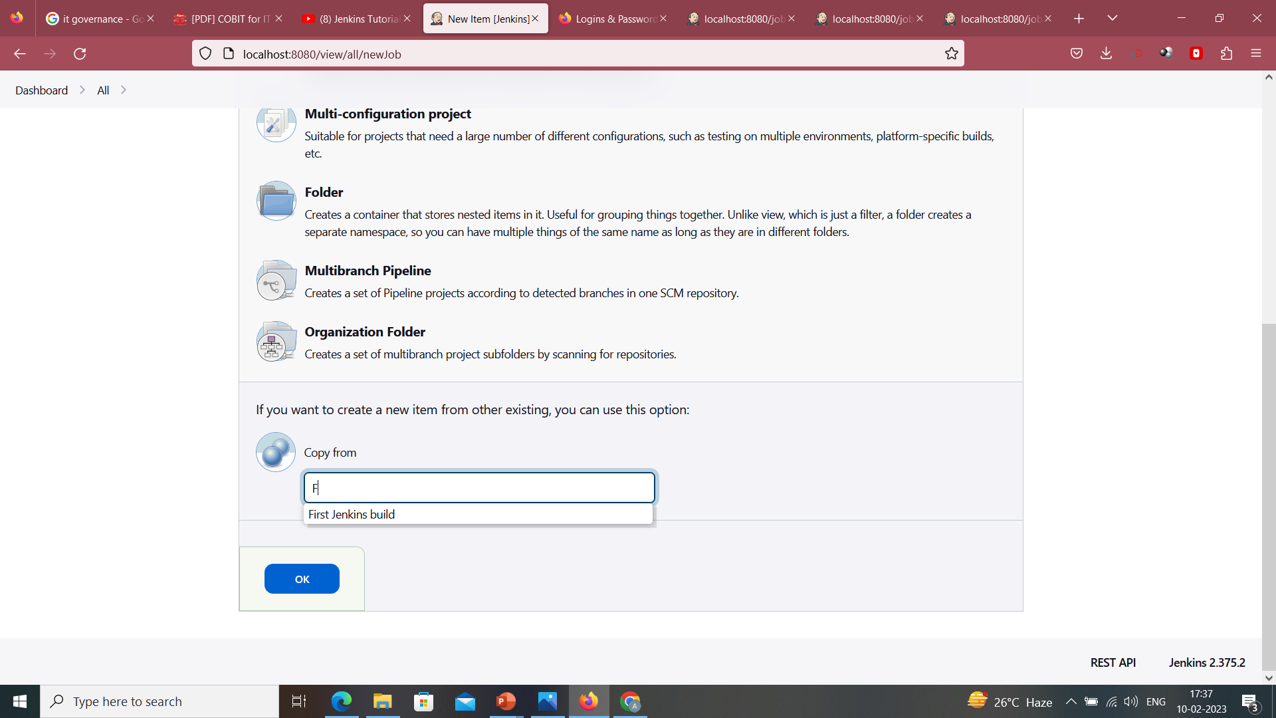

Slide 13
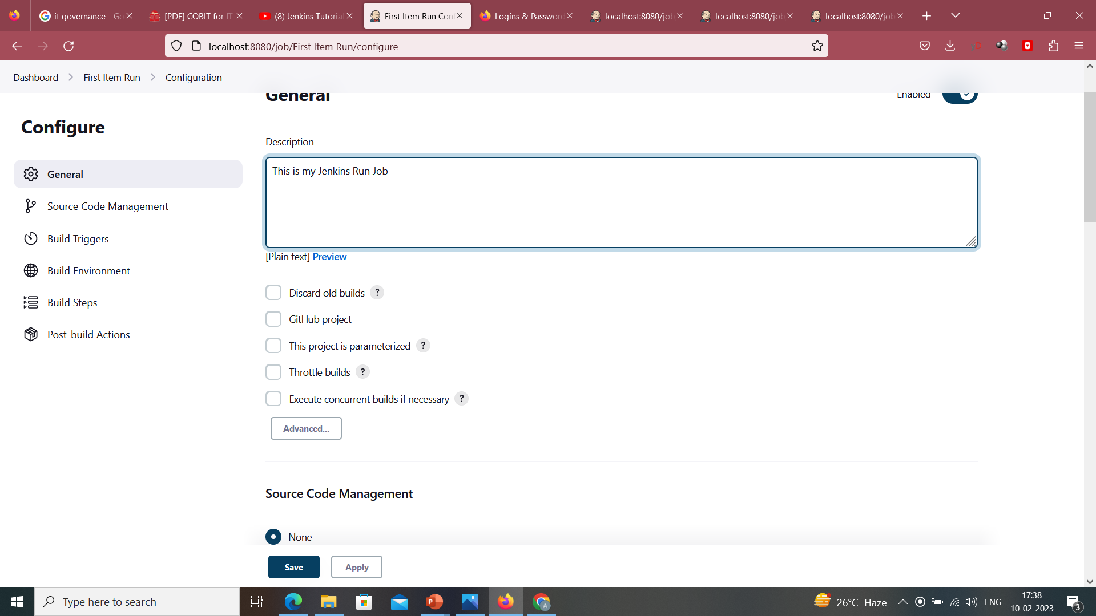

Slide 14
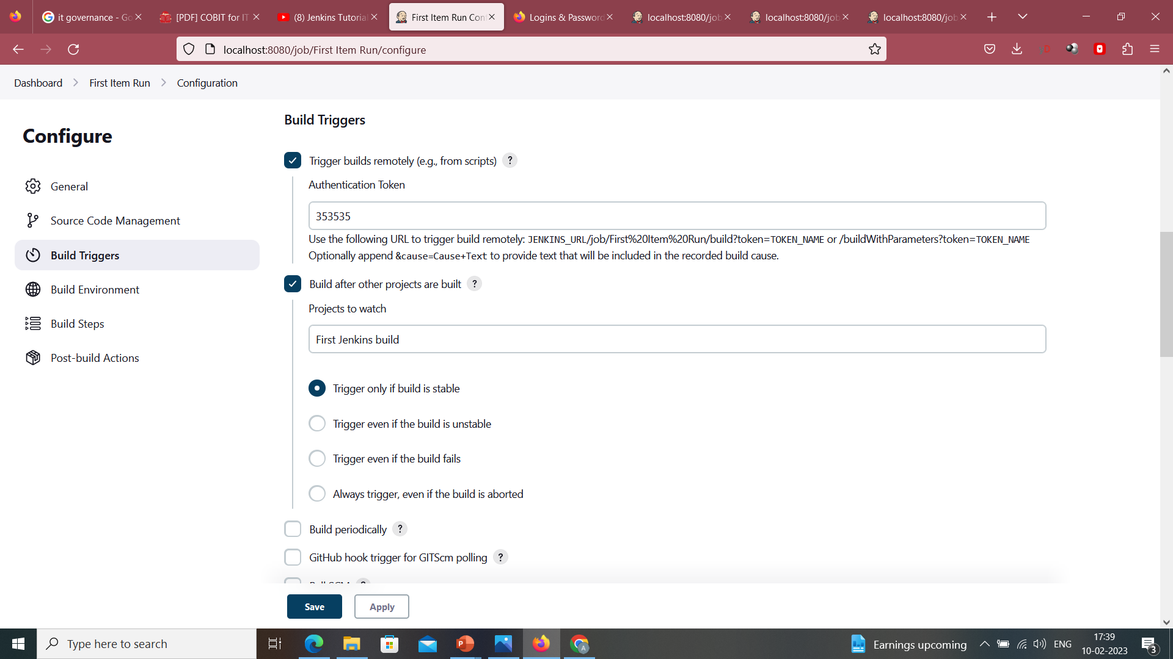

Slide 15
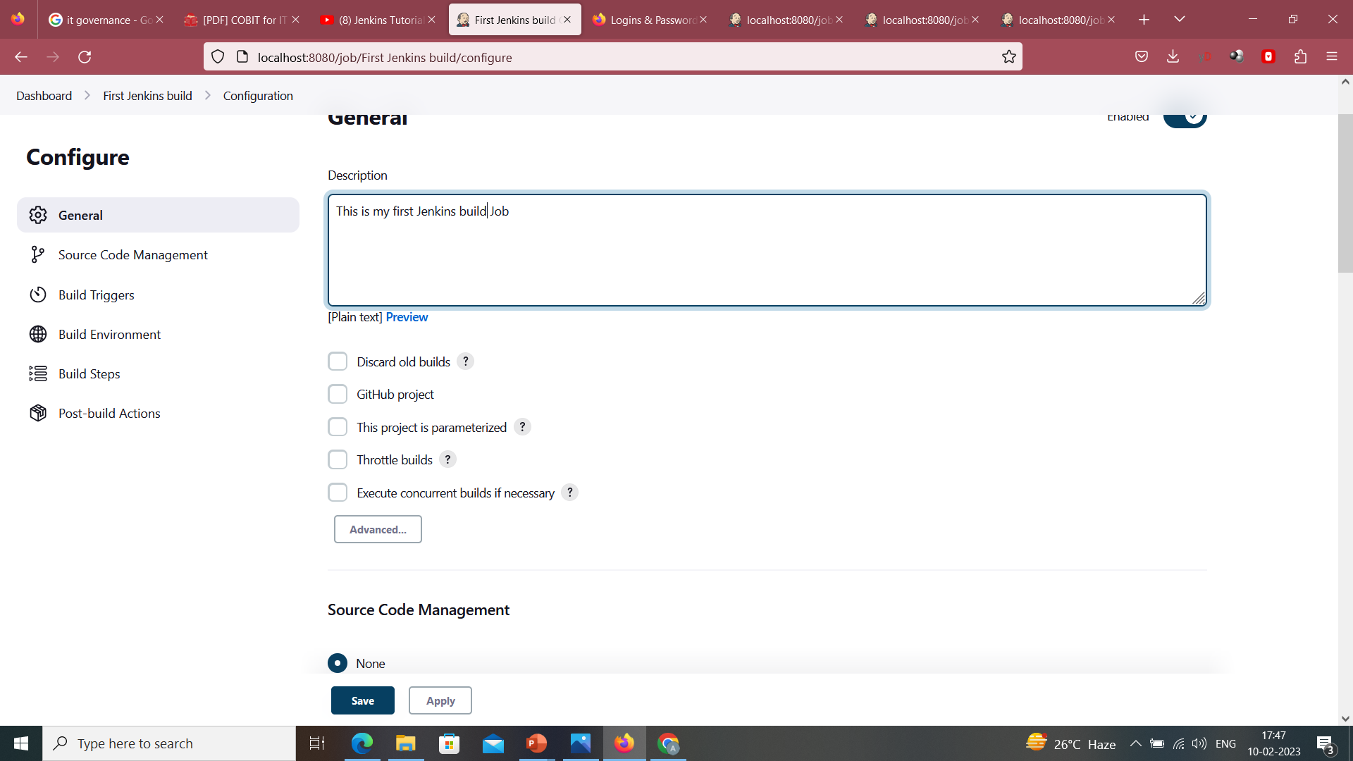

Slide 16
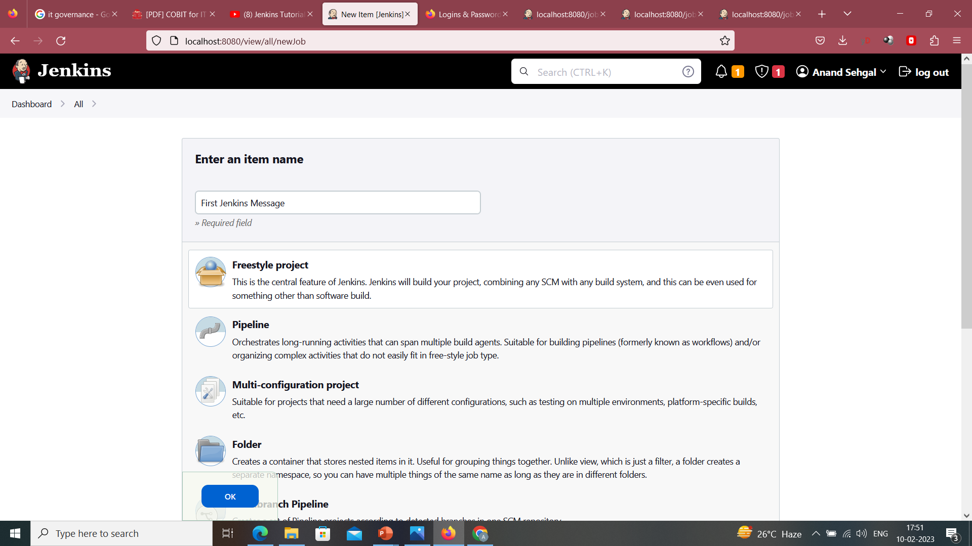

Slide 17
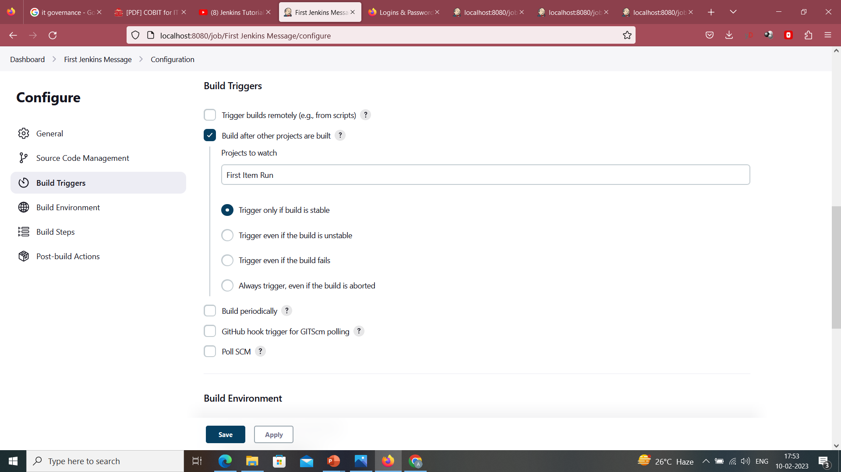

Slide 18
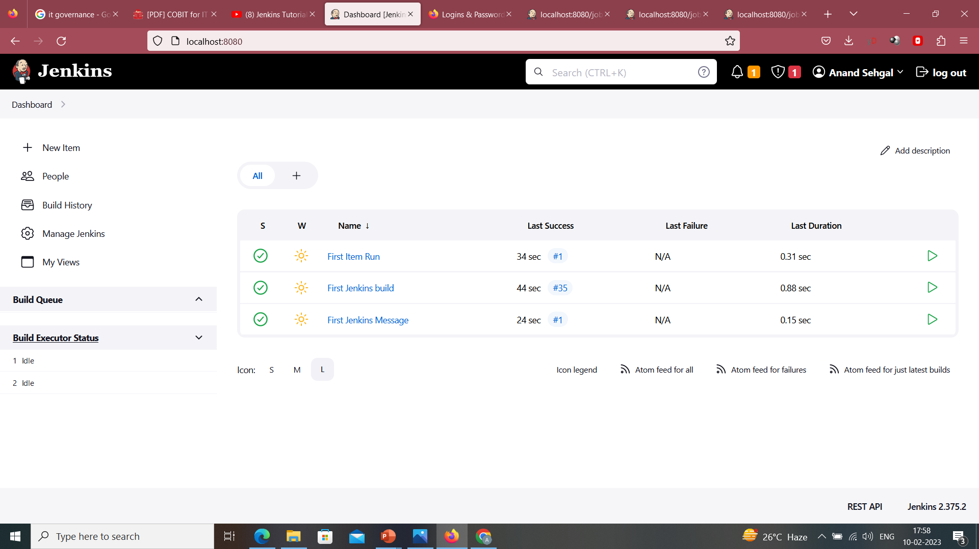

Slide 19
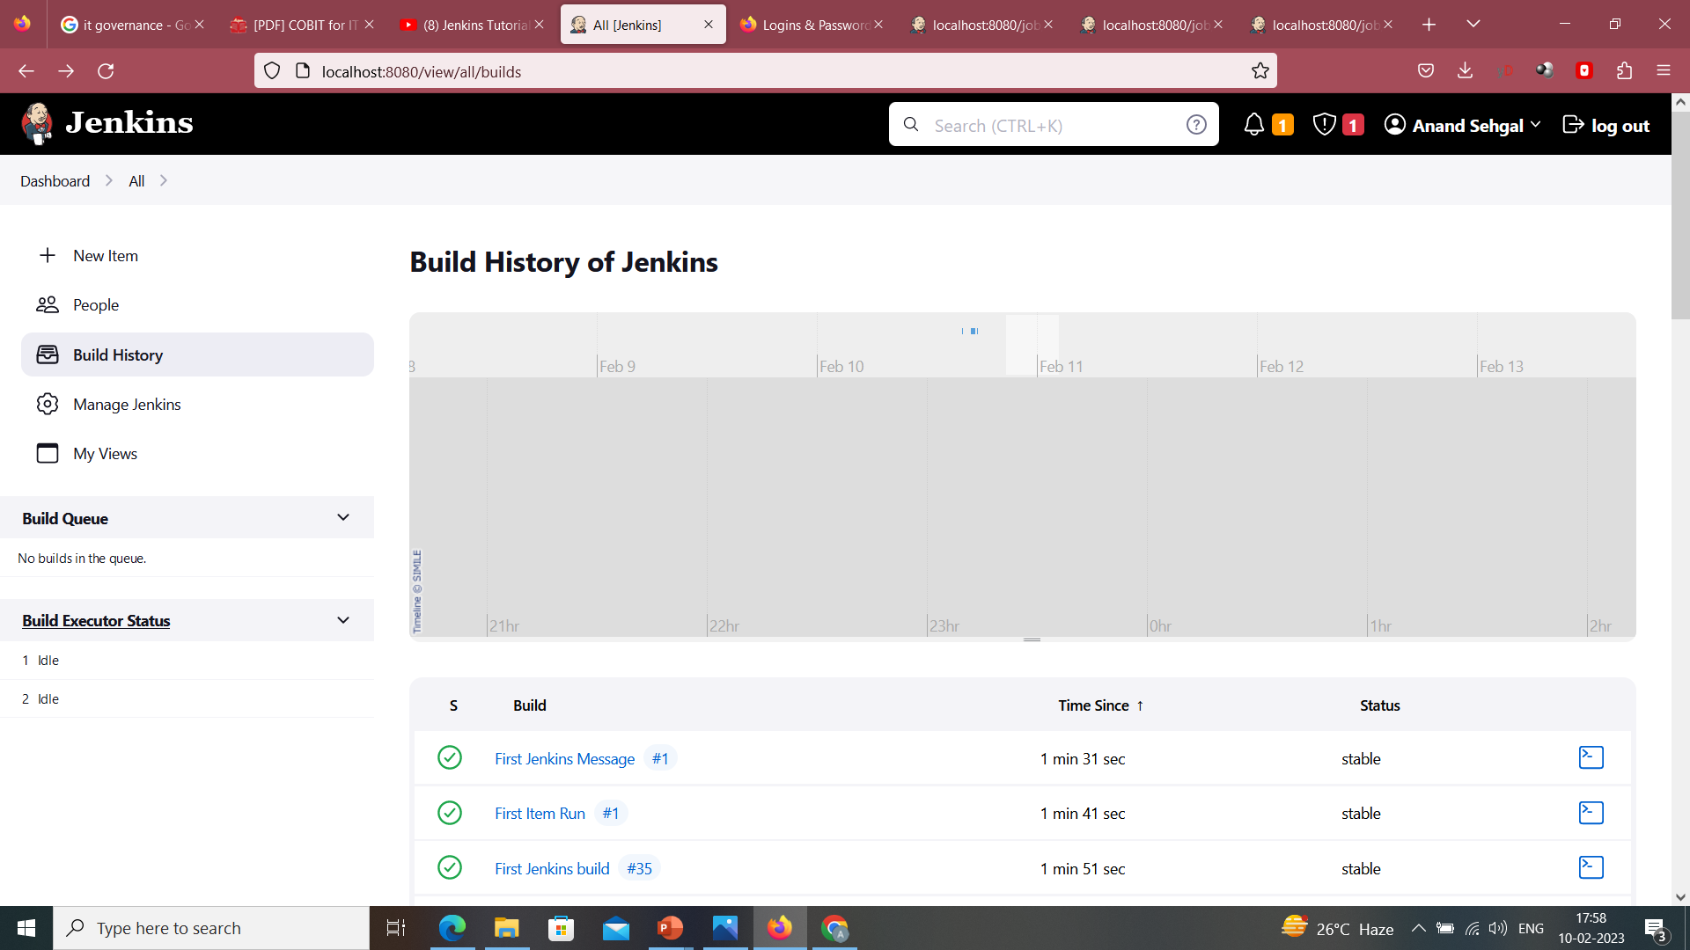

Slide 20
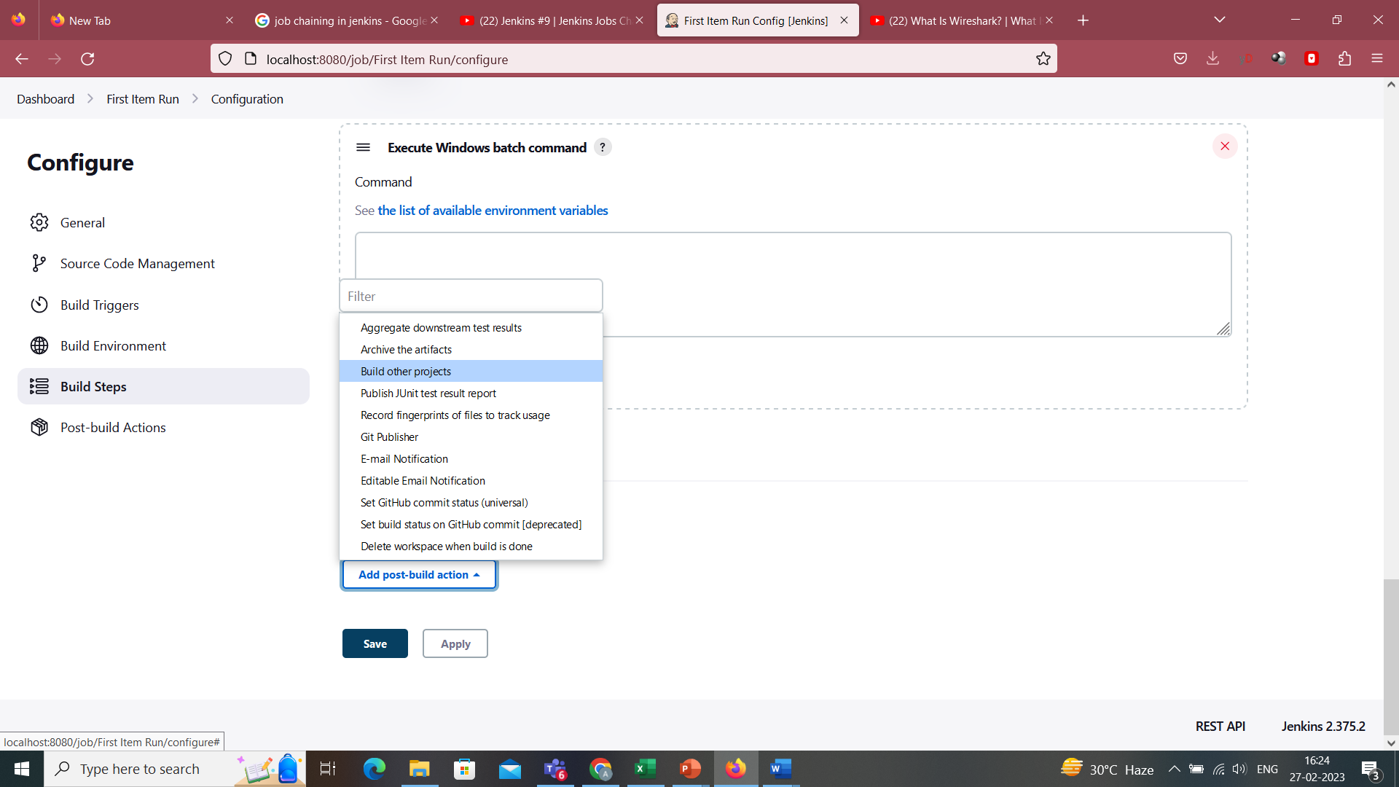

Slide 21
